Slide 1
Targeted Currencies Network
Econosphere Orientation
“Business Without Walls”

Slide 2
Introducing the Econosphere
Why an “open system?”
How does it work?
How can I participate?

Slide 3
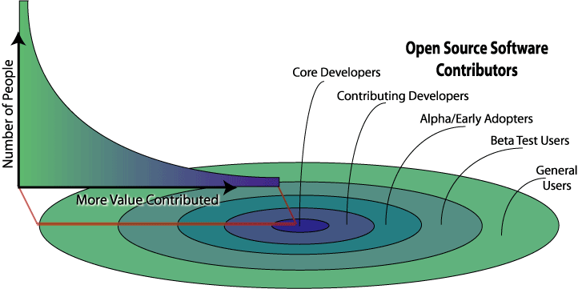
The Open Source Phenomenon

Slide 4
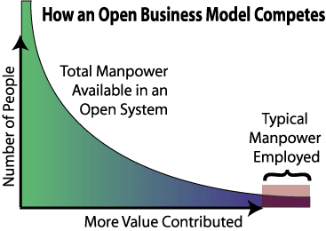

Slide 5
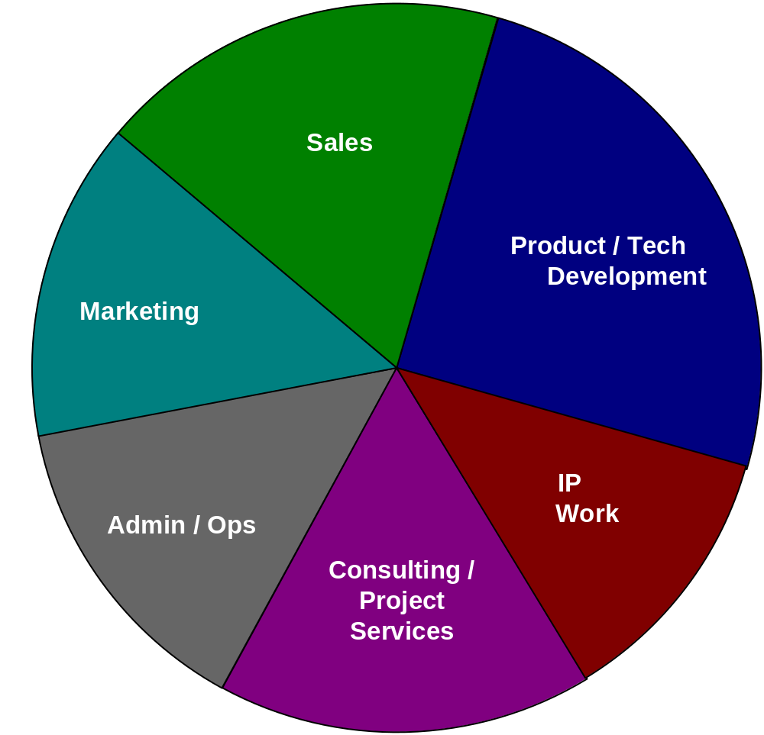
The Econosphere
Lots
Where Do You Want to Play?

Slide 6
Econosphere Teams
Marketing Team - Crafts and shares our message through personal, written, and electronic means, including speaking at conferences, the creation of marketing materials such as brochures, and the maintenance of our marketing website.
Sales Team - Matches the needs of communities and organizations with the tools and talents of our company. They make and track new sales leads and contacts, perform sales appointments with potential customers, and create proposals and contracts.
Delivery Team - Delivers our solutions to our customers. This involves currency design, project management, training and customer support.

Slide 7
Econosphere Teams
Ops Team - Provides the foundation for all the domains to run smoothly. Operational, financial and legal tasks fall here. The Ops Team handles internal technical requests, manages bookkeeping and Intranet/Econosphere web site maintenance, and tracks tasks, incentives and compensation.
Tech Team - We be the geeks. This is where we build our technology infrastructure for currency systems, and provide the infrastructure we need within the company.
IP Team - Responsible for ensuring that the ideas we develop continue to be available to the communities we seek to impact. They identify and document the processes, ideas, and technology that we design. We interface with the Currency Commons and take selected ideas through the copyright, trademark or patent process as appropriate.

Slide 8
How it Works
Play for Points
Achieve the Goals
Reap the Rewards

Slide 9
Play for Points
You earn points by completing tasks.
The tasks in each domain have a particular point value and help forward the goals of that domain.
Example:
Sales
Task Name | Points
Making a cold sales call | 50
Enter a lead into the lead tracking system | 25
Initial Sales Call - Scheduling a Appt (This includes qualifying lead process) | 150
Leading a Sales Appt. - Documenting needs & goals | 300
Follow up communication (TY card, email, etc) | 50
Proposal Letter / Outlined Solution | 300
Further Demos / Appts | 100
Formal/Custom Proposal | 750
Terms & Contracts | 500
Closing a contract | 2500
Initial Payment | 200
Getting x Referrals | 50

Slide 10
Achieve the Goals
Rewards are budgeted based on reaching specific measurable goals.
The higher the score on the measures, the more Lots your points are worth.
Example:
20% | 25 Leads Recorded in Tracking System
35% | 3 New Appointments Happen, Plus one Appt for a >$250K Project
15% | 3 New Solution Outlines Sent
15% | 1 Formal Proposal
15% | 1 Contract Closed
Sales Team is budgeted 10,000 Lots for this month
Accomplished 80% of the measures
Rewarded 8,000 Lots

Slide 11
Reap the Rewards
Convert your Lots to:
  Cash
  Other Exchangeable Currencies
  Ownership in the Company
Conversion rates are posted regularly

Slide 12
TCN Ownership Structure
Denizen Class
  Allocated to all participants who earn Lots
  Vote for Managers of LLC
Preceptor Class
  Allocated to participants who convert Lots to equity
  Vote for Vision Council
  Primary Ownership Rights
Magnate Class
  Individuals or organizations that invest cash or cash-valued goods into the Company

Slide 13
Get Started!
Go to
http://Econosphere.TargetedCurrencies.net
to create an account!

